Slide 1
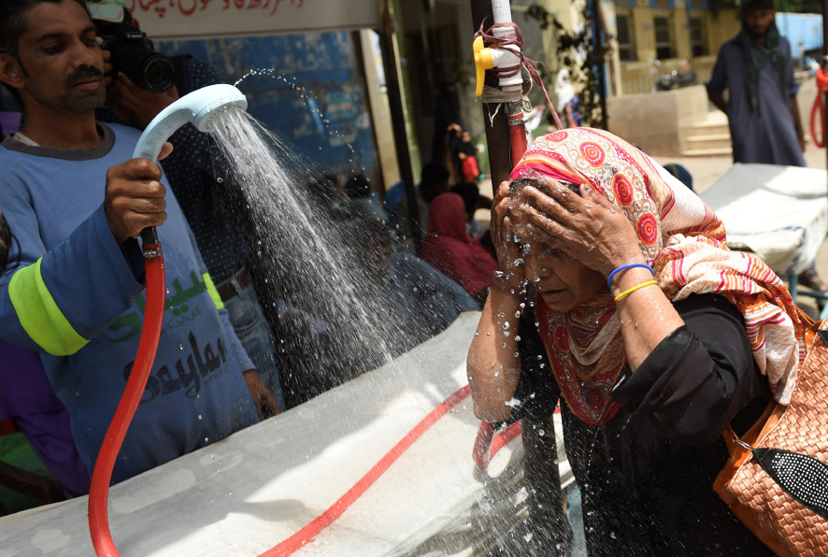

How climate change is driving extreme heat globally
Improving the Humanitarian Response to Heat Events
Roop Singh
Red Cross Red Crescent Climate Centre

Slide 2
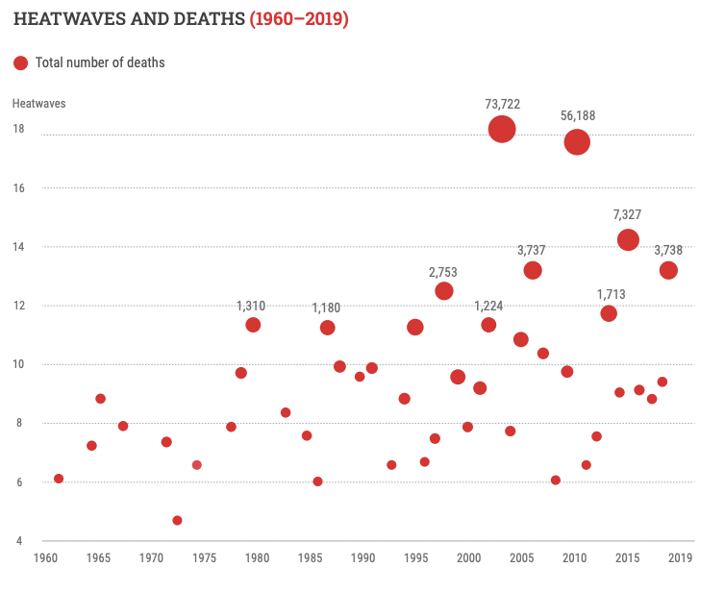
Extreme Heat is a pervasive and growing threat to human health, infrastructure and economic productivity.
Heatwaves are deadly. Low-income communities, children, elderly, disabled, and ethnic minorities are amongst the most susceptible.
Extreme heat reduces labor productivity and economic outputs
  Urban heat stress is expected to reduce labour capacity by 20% in hot months by 2050
Heatwaves damage infrastructure by buckling roads and railways, melting road asphalt, and softening pavement material
  An estimated $569M will be required to maintain and repair roads in Malawi, Mozambique and Zambia through 2050

Slide 3
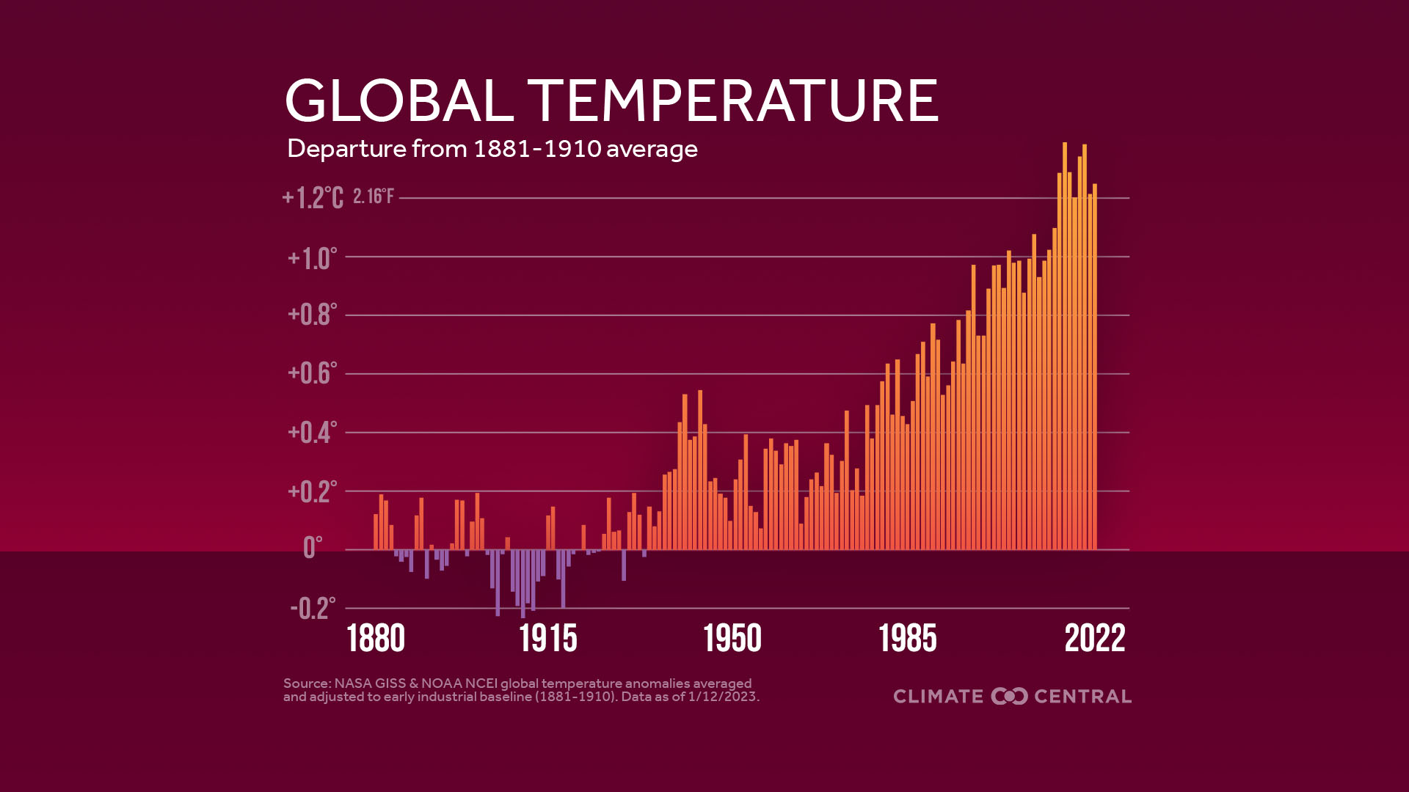

Slide 4
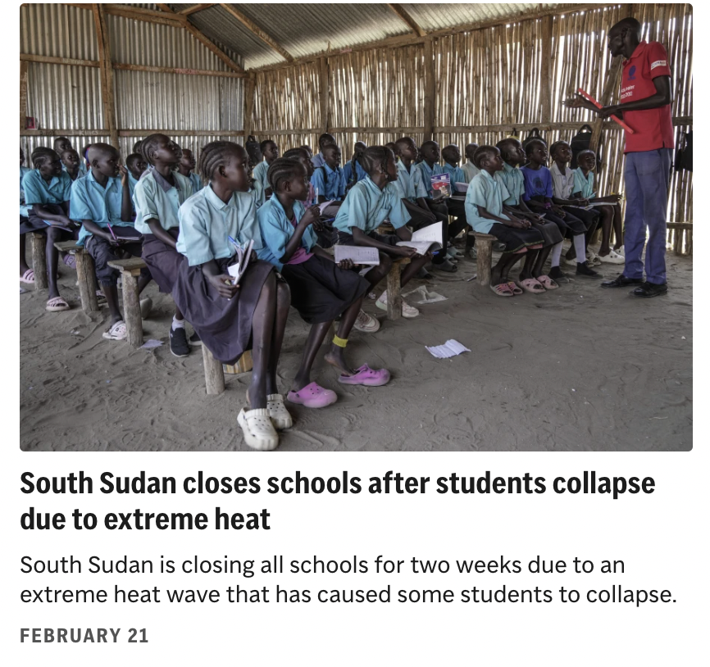
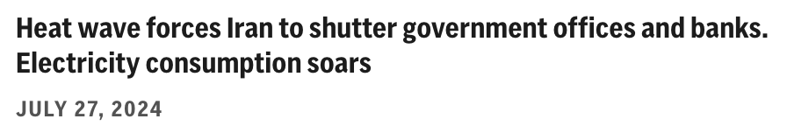
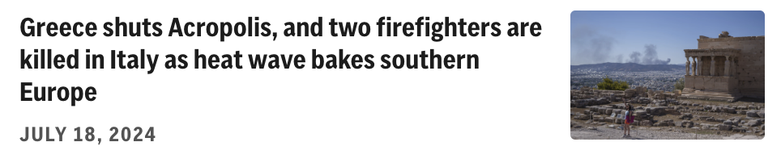
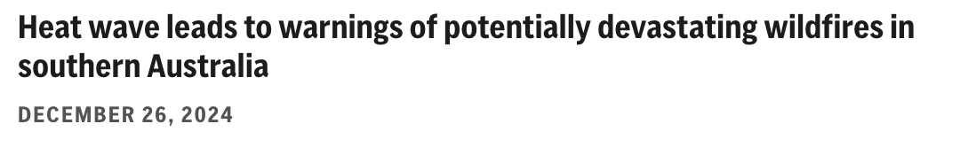
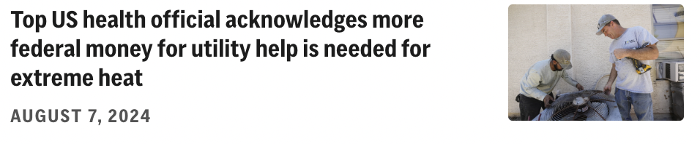
Extreme heat often make the headlines . . .

Slide 5
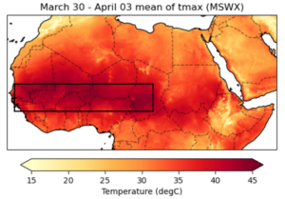
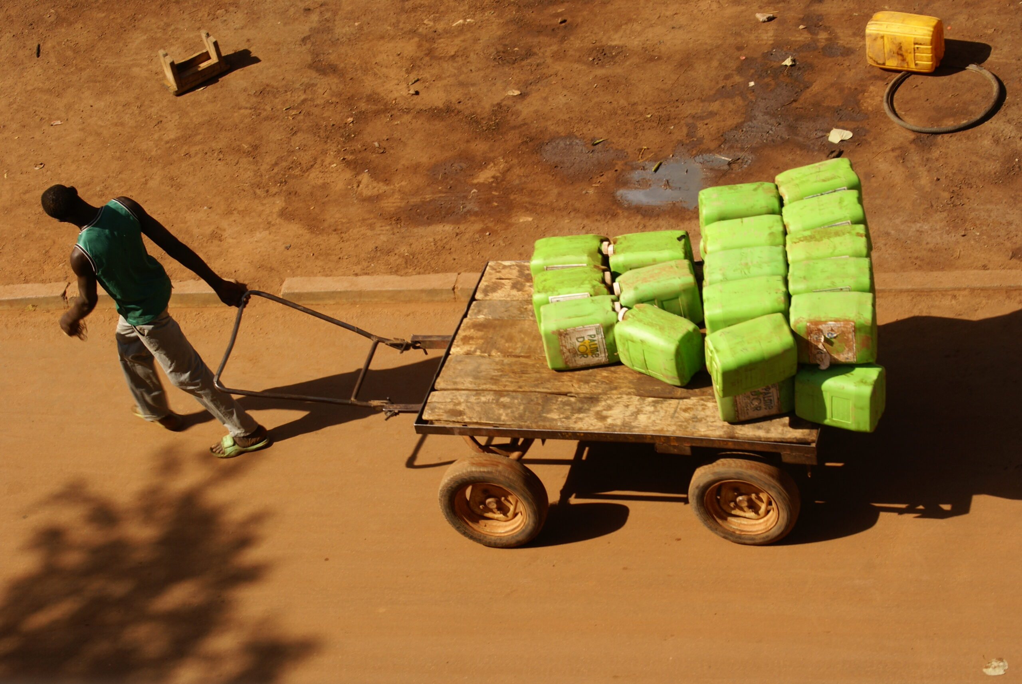
Sahel Heatwave 2024:
Was it climate change?
Maximum temperatures in the Sahel reached more than 45°C
minimum temperatures of 32°C in Burkina Faso
Kayes in Mali recorded 48.5°C on 3 April.
Surge in hospital admissions and 102 deaths recorded at Gabriel Touré hospital in Bamako, Mali
Around half were over the age of 60, and the hospital reports that heat likely played a role in many of the deaths
Notes:
in April 2023, the hospital recorded 130 deaths over the entire month

Slide 6
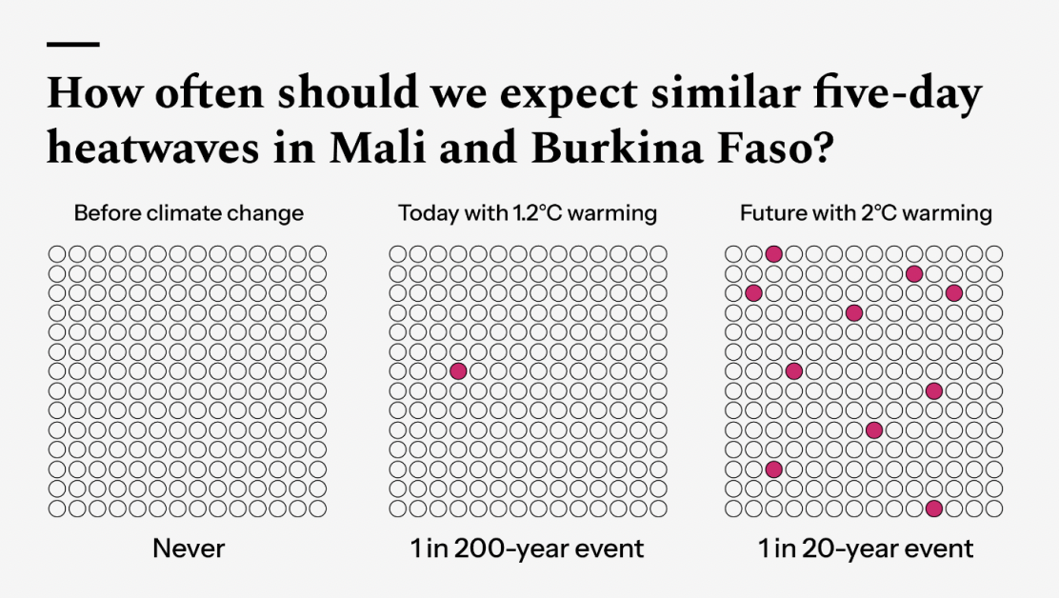
Sahel Heatwave 2024: Was it climate change? YES!
The 5-day maximum temperatures were particularly unusual with a return time of 1 in 200 years
Observations and models both show that heatwaves with the magnitude observed in March and April 2024 in the region would have been impossible to occur without the global warming of 1.2°C to date
Key V&E factors include: rapid urbanization, loss of green spaces in cities, high social vulnerability, limited coverage and resilience of critical systems including electricity, water, and healthcare.

Slide 7
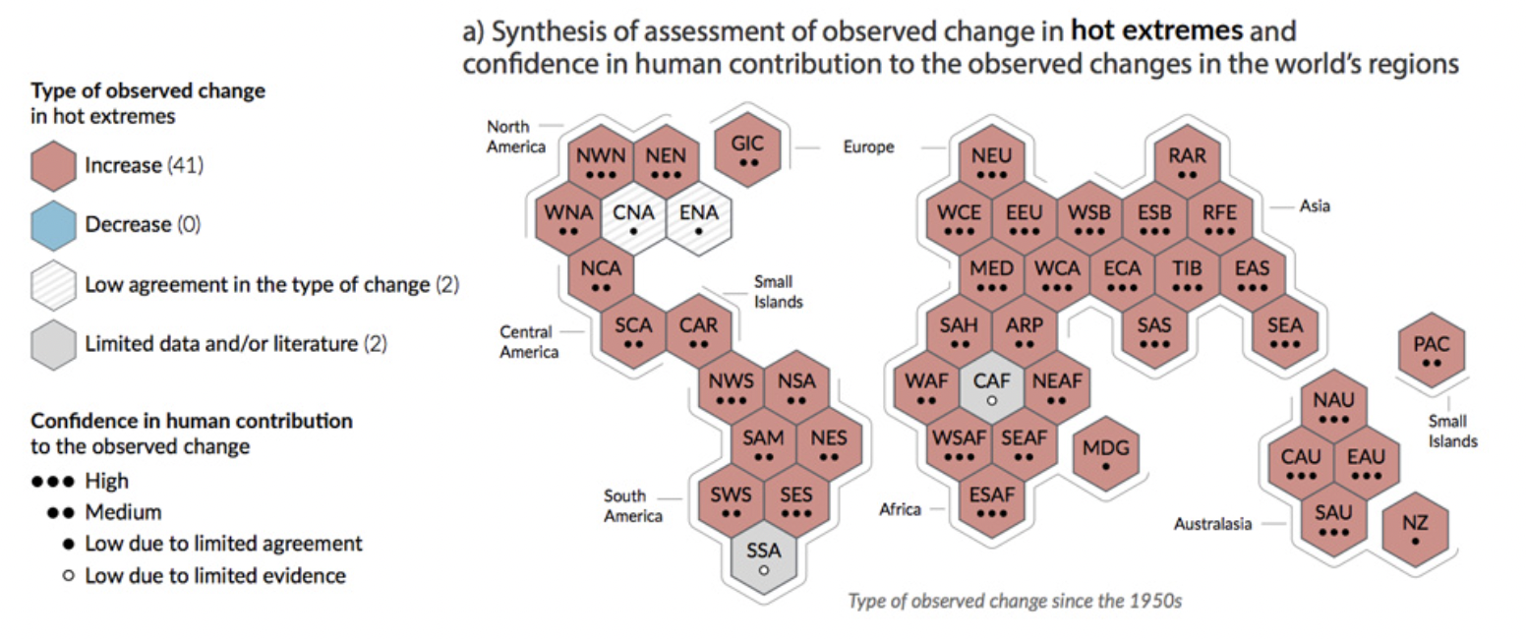
Hot extremes are getting hotter almost everywhere

Slide 8
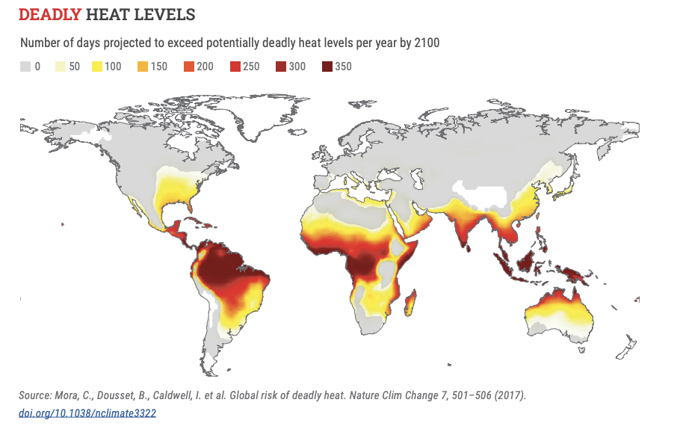

Slide 9

Climate change in cities
The future is urban. An additional 2.5 billion people will live in urban areas by 2050. 90% of this increase will be in Africa and Asia.
The biggest growth will be in small and medium sized settlements, with many people moving to informal settlements and “peri-urban” areas.
This growth will expose more people, infrastructure and assets to climate change impacts.

Slide 10
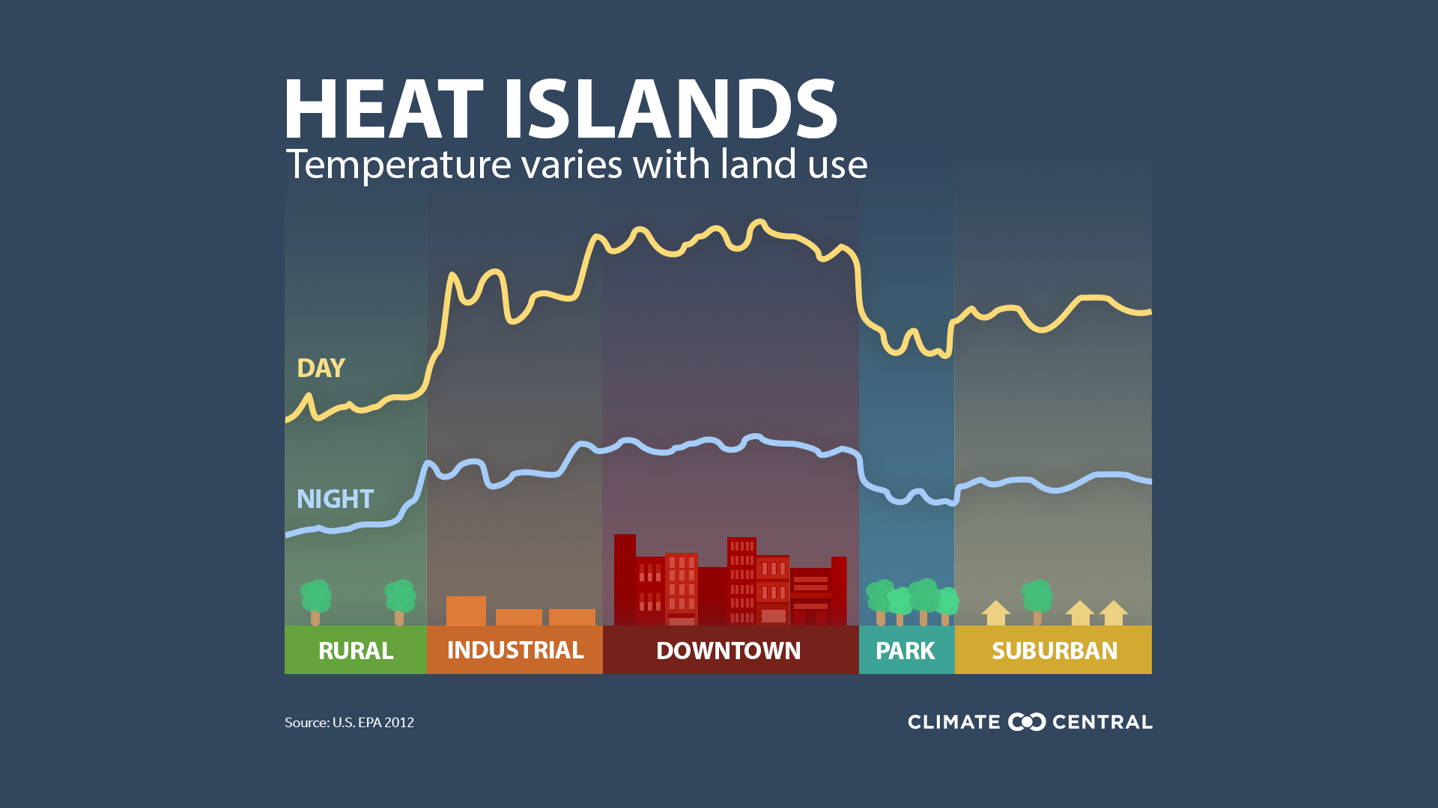

Slide 11
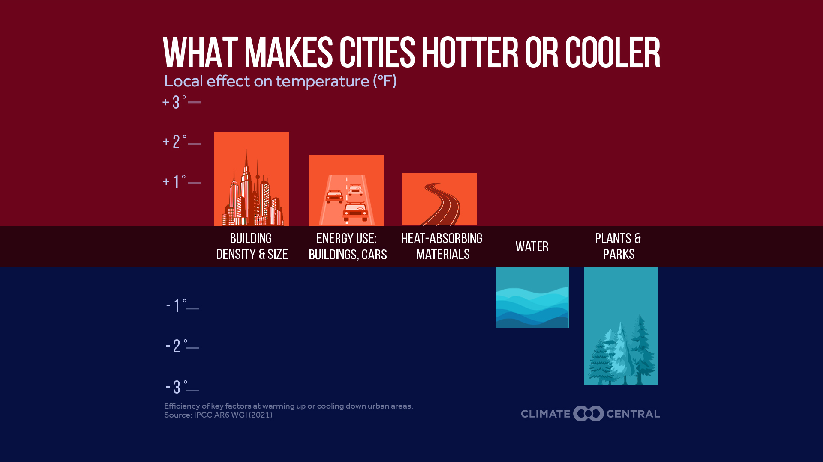

Slide 12
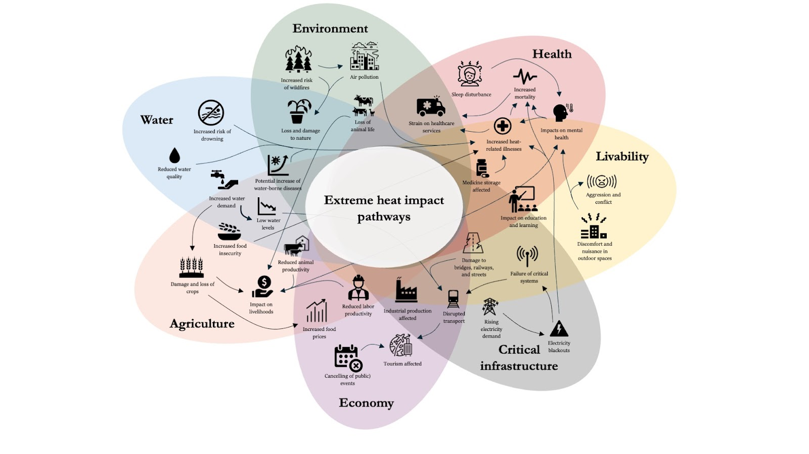

The impacts touch on many aspects of our lives and can cascade across systems.

Slide 13
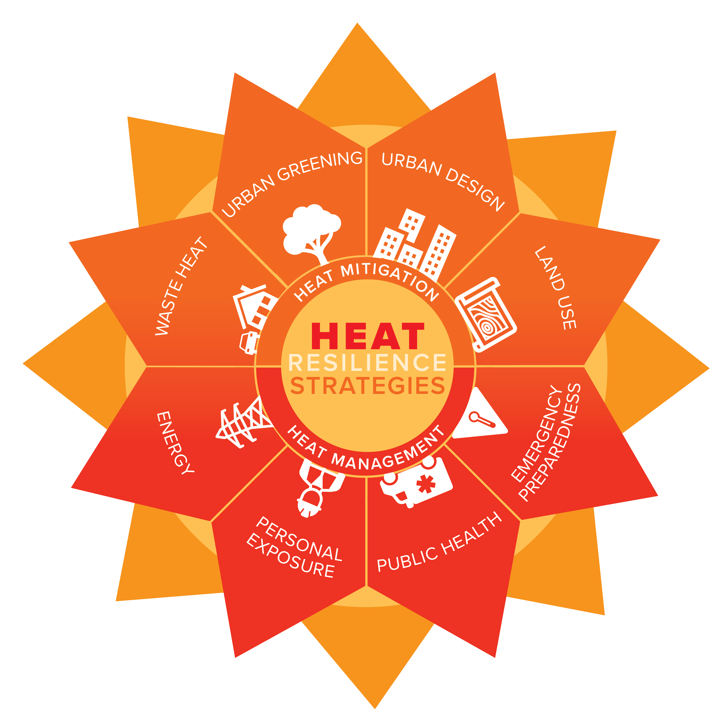
There are many solutions across sectors
Personal Safety Behaviors (e.g. drinking water, avoiding the hottest time of day, first aid for heat illness, awareness raising campaigns)
Cooling the built environment (e.g. passive cooling, cool surfaces, urban planning, building materials, nature-based solutions)
Policy interventions (e.g. Heat Action Plans, Heat EWEA, social protection schemes, building standards and codes, mitigation)

Slide 14
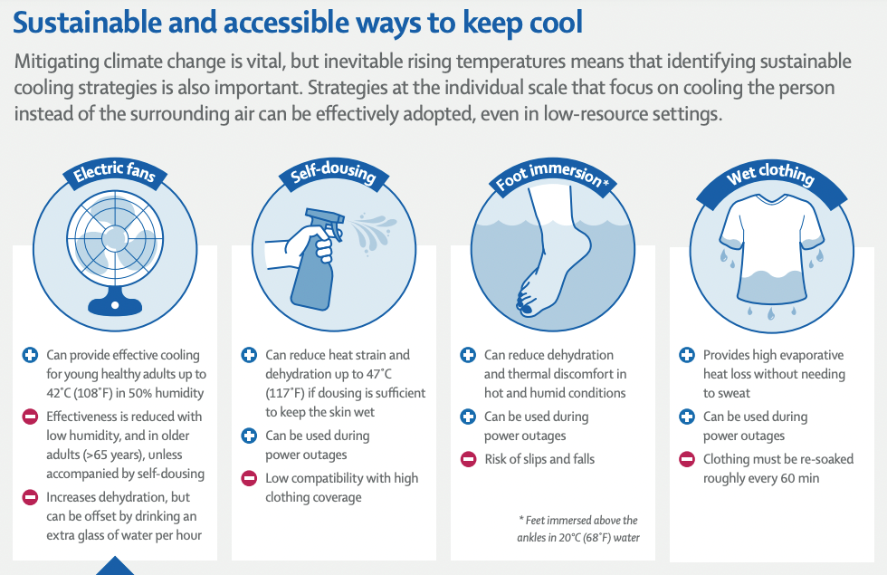

Heat Solutions

Slide 15
Thank you
Questions: singh@climatecentre.org

