Slide 1
Fiji National Cluster System for Disaster Risk Management

Slide 2
Cluster System for Coordination
Coordination in emergencies is vital
Less gaps and overlaps
Coherent, complementary approach
Working together for better collective results
Global Cluster coordination system adopted
Clusters:
Are groups of organisations working in the main sectors of humanitarian action
Provide a clear point of contact and are accountable for adequate, appropriate action
Create partnerships between international humanitarian actors, national & local authorities, and civil society.

Slide 3
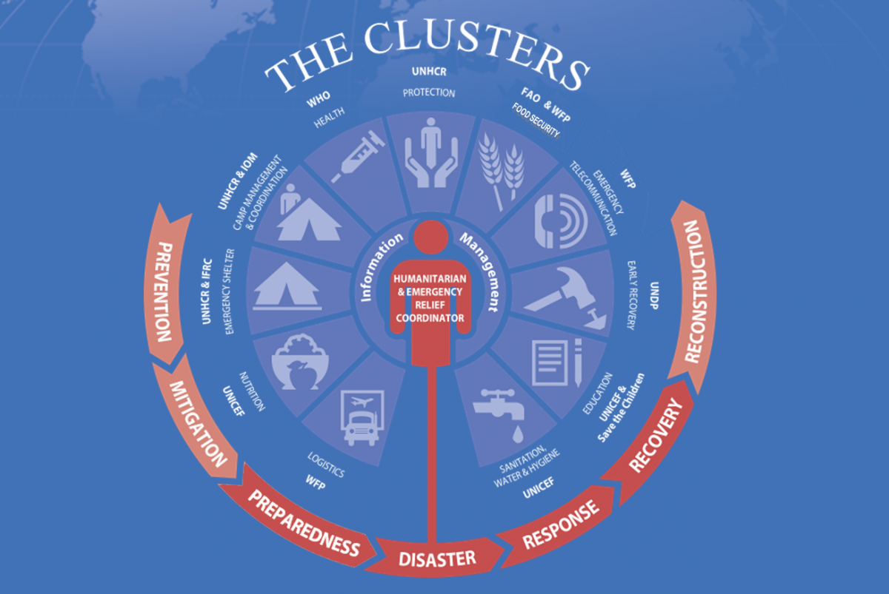
Global Cluster System

Slide 4
From Global System to National System
Workshop held Suva (Holiday Inn) on 19/20 November – attended by wide range of stakeholders at National and Divisional Level
Workshop identified need for improvements in coordination
Eight Clusters identified for Fiji, based on Global system
Adoption of Global Clusters assists understanding of the role of the cluster, with access to TORs, SOPs
Close relationship to Global helps potential for assistance for partnering, training, related funding

Slide 5
Fiji Disaster Management National Clusters
CORE
Coordination
Planning
Funding
WASH
Health & Nutrition
Shelter
Logistics
Food Security & Livelihoods
Public works & Utilities
Safety & Protection
Education

Slide 6
Preparedness
The arrangements and systems to ensure that communities are prepared should an emergency occur and that all those resources and systems which are needed to cope with the affects can be efficiently mobilised and deployed.
Response
The actions taken in anticipation of, during, and immediately after, an emergency or disaster to ensure that all the impacts are minimised and that people affected are given immediate relief and support.
Early Recovery
Coordinated processes for post-crisis recovery that are resilient and sustainable, encompassing the restoration of basic services, livelihoods, transitional shelter, security, environment and other socio-economic dimensions including reintegration of displaced populations.
Fiji Disaster Management Cluster Roles
WASH
Shelter
NDMO NEOC
Food Security & Livelihoods
Education
Health & Nutrition
Safety & Protection
Public Works & Utilities
Logistics

Slide 7
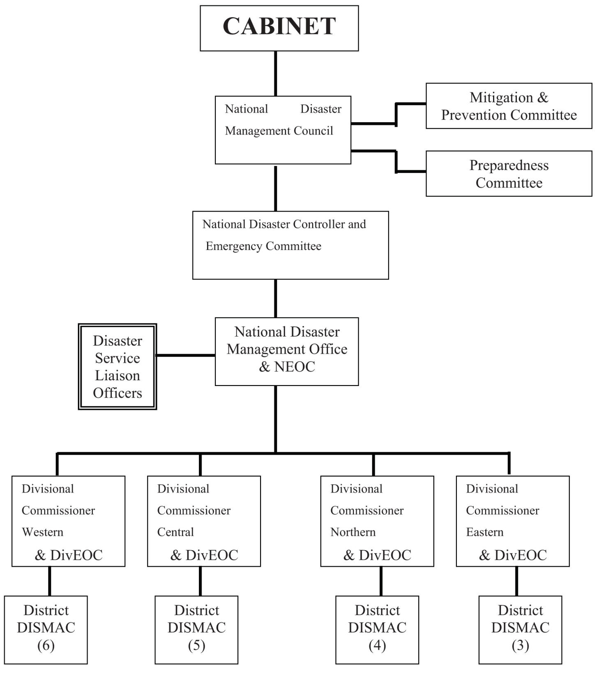
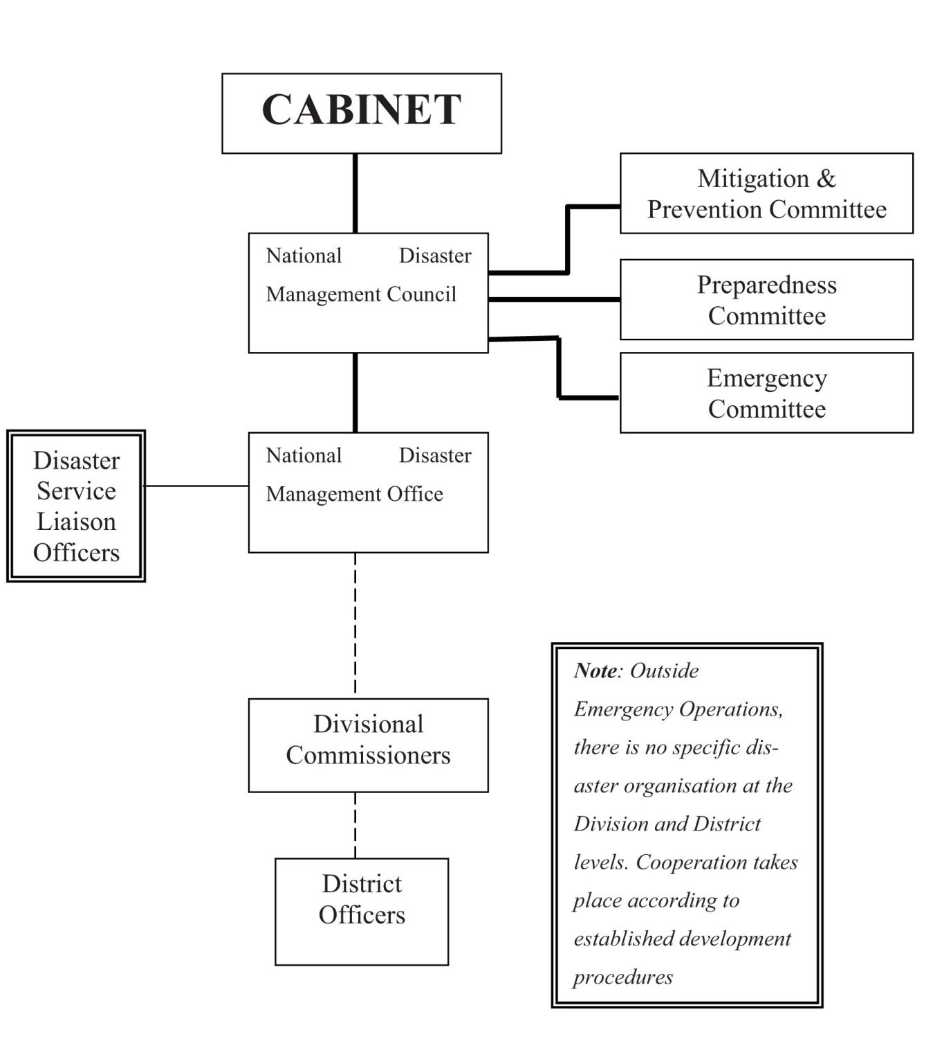
Fiji Disaster Management Existing Structure
Permanent bodies of the Disaster Management Structure
Disaster Management Structure during emergency operations

Slide 8
Fiji Disaster Management National Cluster Framework
CABINET
Minister for Provincial Development and National Disaster Management
NDMC
DSLOs
WASH
National Disaster Controller
Shelter
NDMO NEOC
Food Security
Education
Division DISMAC
Health & Nutrition
Safety & Protection
Divisions
National DISMAC
Public Works
WASH
Logistics
Shelter
Food Security
DIVEOC
Education
Provinces
Safety & Protection
Health & Nutrition
Logistics
Public Works
Districts
DISEOC
Communities
District DISMAC
Cities / Towns / Villages / Rural Areas

Slide 9
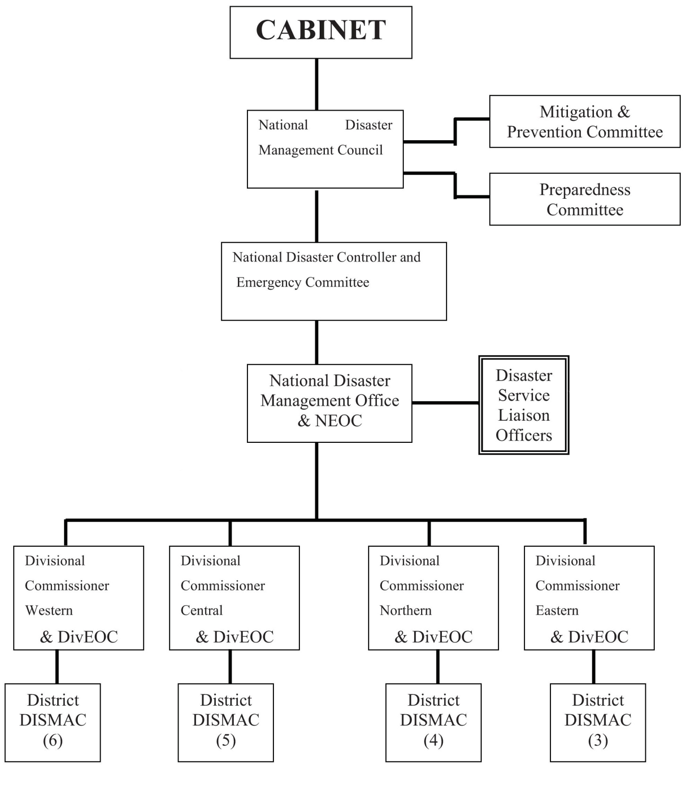
Fiji Disaster Management National Clusters and Pacific Humanitarian Team

Slide 10
Fiji Disaster Management National Clusters and Pacific Humanitarian Team
Emergency Relief Coordinator
Resident Coordinator
Pacific Humanitarian Team
National Cluster
Division Cluster
District Cluster Partnership

Slide 11
Fiji Disaster Management National Clusters at Divisional and District Levels
DSLOs
All Agencies
Controller
NEOC
Division HODs
All Agencies
Division Commissioner
DivEOC
District/Provincial HODs
DO / PA
All Agencies
DisEOC

Slide 12
Fiji Disaster Management National Clusters at Divisional and District Levels
DSLOs
All Agencies
Shelter
Safety & Protection
Health & Nutrition
Public Works & Utilities
Food Security & Livelihoods
Logistics
Controller
NEOC
WASH
Education
Division HODs
All Agencies
Shelter
Safety & Protection
Health & Nutrition
Public Works & Utilities
Division Commissioner
DivEOC
WASH
Education
Food Security & Livelihoods
Clusters form partnerships at District /Province Level
District/Provincial HODs
DO / PA
All Agencies
Cluster Partnerships
DisEOC

Slide 13
Fiji Disaster Management. Cluster Lead and Co-Lead Roles
The role of the Cluster Lead to facilitate the work of the Cluster, to ensure:
Key Partners are included
Appropriate coordination
Cross-cutting issues are addressed
Effective needs assessment and analysis
Adequate contingency planning and preparedness
Application of standards, monitoring and reporting
Advocacy and resource mobilisation
Training and capacity building
The role of the Cluster Co-Lead should be to provide technical support to the Lead as required

Slide 14
Core
Agencies
Government Lead
NDMO
Co-Lead
UNOCHA
Key Partners
Cluster Leads and Co-Leads
Ministry of Finance
Ministry of Foreign Affairs and International Cooperation
Prime Minister's Office
Ministry of Public Enterprises, Communications, Civil Aviation and Tourism
Ministry of Strategic Planning, National Development & Statistics
Ministry of Information
Itaukei Affairs
Public Service Commission Fiji Red Cross
The Core of the proposed Fiji DM Cluster system is to provide all of the services required to ensure that the work of each Cluster is appropriately facilitated, coordinated and supported. Roles for the Core are summarised as coordination, planning, and funding.
The NDMO is listed as the logical lead for the Core, with UNOCHA playing a supporting Co-Lead role for coordination, information and assisting efforts for international assistance where deemed necessary.

Slide 15
1. Education
Agencies
Government Lead
Ministry of Education
Co-Lead
UNICEF, Save the Children
Key Partners
Embassy of Japan
AQEP (Access to Quality Education Program)
AusAID
Ministry of Provincial Development - Divisional Offices
UNOCHA
UNWomen
The Education Cluster is accountable for ensuring a more predictable, timely and effective education response, with inter-sectoral links to other relevant clusters.
Inter-Agency Network for Education in Emergencies – website http://www.ineesite.org/post/educationcluster/

Slide 16
2. Public Works & Utilities
Agencies
Government Lead
Ministry of Works, Transport and Public Utilities
Co-Lead
NDMO
Key Partners
Fiji Electricity Authority
Water Authority of Fiji
Fiji Meterological Service
Fiji Roads Authority
Mineral Resources RFMF Police NFA Corrections
Ministry of Provincial Development - Divisional Offices
Land Transport Authority
Government Shipping Services
Telecom Fiji Limited
Fiji Islands Maritime Safety Administration
Civil Aviation Authority of Fiji
Prisons and Corrections
Forestry Department
SPC
Digicel
Vodafone
The goal of the Public Utilities and Works Cluster is to: plan and implement public utility preparedness activities to help build resilience to disasters
respond to the impacts of disasters so that affects on public utilities are minimised and people are not placed at risk, and
deliver early recovery works to allow a return to normalcy as soon as possible.
Public utilities are defined as all of the utilities and infrastructure required for communities to operate normally, including electricity, water, roads, transport, communications, shipping and civil aviation.

Slide 17
3. Health & Nutrition
Agencies
Government Lead
Ministry of Health
Co-Lead
WHO
Key Partners
Department of Agriculture (DOA)
Fiji Health Sector Support Program
Ministry of Provincial Development - Divisional Offices
NDMO
FIBOS (Data on EA)
UNICEF
FAO
SPC
UNFPA
FRCS
Fiji Disabled Persons Federation Empower Pacific
UNOCHA
AusAID
IFRC
The Health Cluster goal is to reduce avoidable mortality, morbidity and disability and restore the delivery of and equitable access to preventative and curative health care as quickly as possible and in as sustainable a manner as possible The Health Cluster includes nutrition activities.

Slide 18
4. WASH
Agencies
Government Lead
Ministry of Health (Environmental Health)
Co-Lead
UNICEF
Key Partners
Ministry of Women, Social Welfare & Poverty Alleviation
WAF
MWT&PU(WSD)
FRCS
Ministry of Provincial Development - Divisional Offices
WHO
SPC
UNDP
UN Women
IFRC
Save the Children
AusAID
NZAID
Fiji Water Foundation (Rotary)
Fiji Live and Learn
Fiji Water / Aqua
ADRA
Habitat for Humanity
UNOCHA
The goal for the Water, Sanitation and Hygiene Cluster is to improve the efficiency and effectiveness of WASH interventions in emergencies by ensuring effective system-wide preparedness, providing the ability to deliver an immediate and appropriate response and participating in actions to facilitate early recovery.

Slide 19
5. Shelter
Agencies
Government Lead
Ministry of Local Government, Urban Development, Housing & Environment
Co-Lead
IFRC
Key Partners
MOPD&NDM (Rural Housing)
Ministry of Women, Social Welfare & Poverty Alleviation
Ministry of Provincial Development - Divisional Offices
UN Habitat
MoH
FRCS
MOE
Habitat for Humanity Fiji
UNWomen
Housing Authority
AusAID
NZAID
PRB
UNOCHA
Fiji Institute of Engineers
Rotary Fiji
I Taukei Affairs
CSN
PCN
Friend Good Neighbour International Ministry for Labour
The goal of the shelter cluster is to reduce the vulnerabilities related to shelter and settlement of the disaster-affected population, to provide culturally appropriate, environmentally sustainable and adequate emergency, semi-permanent and permanent shelter and to ensure an immediate and effective emergency shelter response for the affected population. The Shelter Cluster goal is also to deliver preparedness strategies for increased resilience and to facilitate actions for early recovery.
Given the above goal, the Shelter Cluster will be also responsible to identify, assess, select and monitor the ongoing availability and suitability of evacuation shelters

Slide 20
6. Logistics
Agencies
Government Lead
Fiji Procurement Office
Co-Lead
NDMO
Key Partners
Ministry of Finance
Act for Peace
RFMF
Customs
Airports Fiji Ltd
FIRCA
Ministry of Provincial Development - Divisional Offices
Fiji Ports Authority
IFRC
Donors: AusAID, NZAid, USAID, JICA
FRCS
Police
NFA
SOPAC
UNICEF
UNOCHA
GSS
The goal of the Logistics Cluster is to plan, implement and control the efficient, cost effective flow and storage of goods and materials, as well as related information, from the point of origin to the point of consumption for the purpose of alleviating the suffering of vulnerable people. The function encompasses a range of activities, including preparedness, planning, procurement, transport, warehousing, tracking and tracing and customs clearance.

Slide 21
7. Food Security & Livelihoods
Agencies
Government Lead
Ministry of Agriculture, Fisheries & Forests
Co-Lead
MoH ? FAO? UNDP?
Key Partners
Ministry of Health
Ministry of Provincial Development - Divisional Offices
Department of Fisheries and Forests
NDMO
SPC
Agriculture Marketing Authority
SPNDNS
International Funding for Agricultural Development
Taiwan Technical Mission
ADRA
National Food and Nutrition Centre
Natures Way
Fiji Crop and Livestock Council
Commercial Stat. Auth. (FSC, Rewa Rice, FMIB)
AusAID, NZAID
The goal of the Food Security Cluster is to plan and implement proportionate, appropriate and timely food security responses in humanitarian crisis situations. In particular, to help ensure that food assistance and agricultural livelihood-based programmes are linked as part of a coordinated response.
The Food Security Cluster integrates food aid, agricultural issues and other livelihood interventions.
A Co-Lead needs to be identified for this Cluster.

Slide 22
8. Safety & Protection
Agencies
Government Lead
Ministry of Women, Social Welfare & Poverty Alleviation
Co-Lead
To be determined
Key Partners
Ministry of Defence, National Security and Immigration
Ministry of Education
Ministry of Youth
Department of Agriculture
Ministry Provincial Development - Divisional Offices
Police
NFA
RFMF
UNWomen
FRCS
Fiji National Council of Disabled People
AusAID
NZAID
Save the Children
FHSSP
Empower Pacific
UNICEF
IFRC
UNDP
UNFPA
UNOCHA
The Protection Cluster goal is to preserve the well-being and dignity of families and children affected by the disaster with effective protection from violence, abuse and exploitation (and extended trauma). Among other things, the Cluster will: engage national and international protection partners in the effective collaboration and coordination of the protection sector response
assess and monitor child protection needs and carry out awareness raising and prevention activities to protect affected families and children from violence, abuse, and exploitation, and
initiate family tracing mechanisms and provide (as needed) psycho-social support and protection services through the establishment of Child Friendly Spaces.
A Co-Lead for this Cluster still needs to be determined.

